Slide 1
Import XML
Import XML

Slide 2
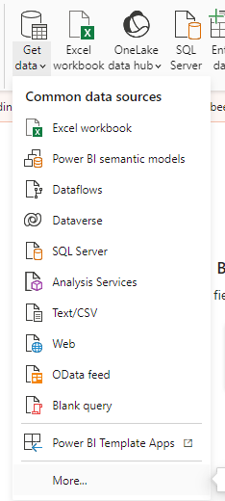
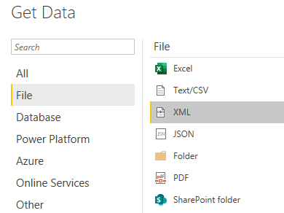
Importing XML
Note: This Lab uses the CustomerOrder.xml file located in the resources / XmlSources folder
Select XML as data source
2
1

Slide 3
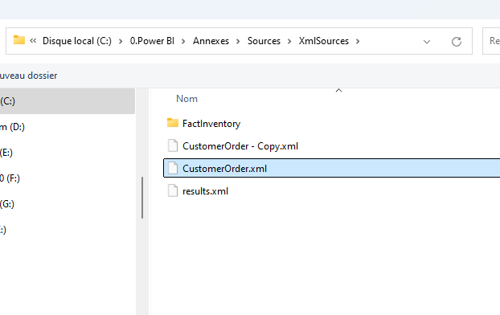
Importing XML
CustomerOrder.xml file from XMLSources

Slide 4
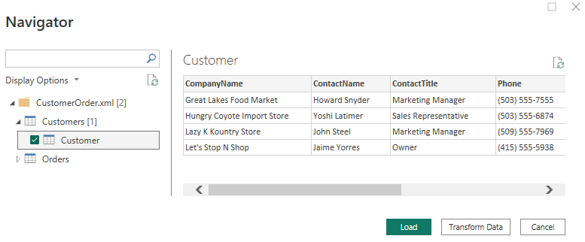
Importing XML
Try selecting Customer alone, then Order alone, then both at once.

Slide 5
Thank you
Thank you

